Slide 1
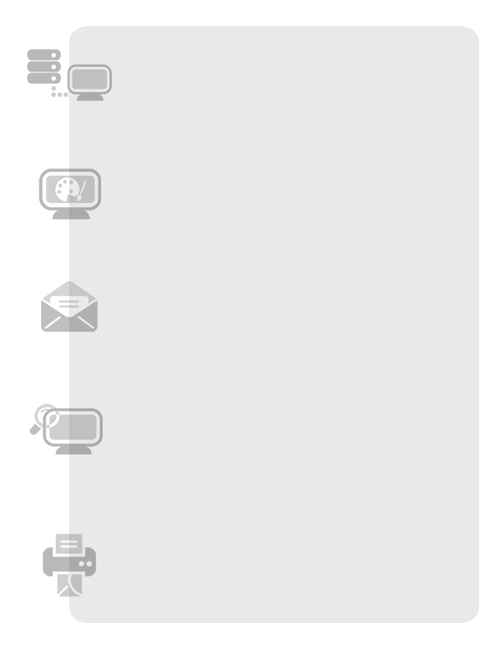

Online fax
Sales Product
Training

Slide 2
Agenda
What is Online Fax?
Who can benefit from Online Fax?
Why Online Fax?
How does it work?
Plans & pricing
What is Included in all Plans?
Features & benefits
Objection handlers
FAQs
Ordering process
Additional resources
Q & A

Slide 3
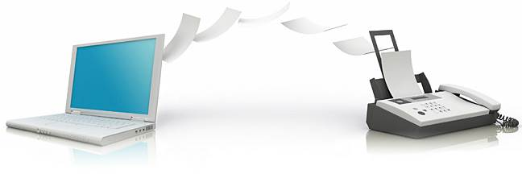
Online Fax
What is Online Fax?
Online Fax is a solution that allows users to send and receive fax communication over the Internet through an email inbox.
Notes:
Traditional faxes are sent and received through a phone line and delivered through a fax machine. With Online Fax, you can receive faxes online and from an email address.

Slide 4
Online Fax
Who can benefit from Online Fax?
Current machine-based fax subscribers
Great solution for a business that receives a lot of faxes
SMBs and SOHOs looking for ways to save time & money
Realtors, lawyers, insurance companies, mortgage brokerages and Title companies, legal firms, health care organizations (Dentist, Doctor), remote workers, take out establishments (restaurants, delis)
Business owners on the go or who have a mobile workforce

Slide 5



Online Fax
Why Online Fax?
Save money!
Reduce paper and toner usage
Save on long distance
No dedicated fax line required
No fax machine maintenance
Save time!
No need to monitor a fax machine
Send faxes immediately. No need to wait until you are in the office
Manage your faxes online. No more paper.
Send faxes once to multiple contacts
Security
Faxes are received directly to an inbox vs. lying around on a fax machine
Includes spam filter – block known numbers
1 year archiving of received faxes
Notes:
1 year archiving begins the day a fax is received. 12 month window begins the day the fax is received.
Spam filter: Online Fax has a spam filter to block known fax spammers.
Will not be HIPPA compliant at launch.

Slide 6


Online Fax
Did you know…..
That conventional fax machines consume over 200 billion pages of paper each year? A reduction of 5% would:
Save 52,000 tons of paper
1.26 million gallons of water
3.15 million pounds of air pollution
Go Green!
Notes:
Another great reason to consider online fax. It’s environmentally friendly!
Sources:
http://www.roanokeva.gov/WebMgmt/ywbase61b.nsf/vwContentByKey/N254HK26166KROEEN
http://www.culvercity.org/environment/livinggreen.asp?sec=env&cat=3
http://www.cenyc.org/greenlife/wasteprevention/recyclingfactstoponder
http://www.co.cass.in.us/ccswd/trivia.htm
http://www.atg.wa.gov/ConsumerIssues/ID-Privacy/DumpsterDiving.aspx
Davidson Consulting, 2010; Sturgis, MI.

Slide 7
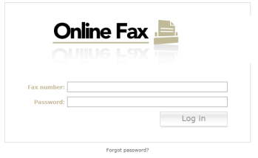
Online Fax
How does it work?
Screenshot of the login portal
After customer orders product, the customer receives a Welcome email from us that contains their new fax number and password.
This email will include the link to the Online Fax login portal (image on left) where the customer will go to send, receive or view their faxes.
Notes:
Customer receives a Welcome email that contains their new fax number and password 1 fax line per account
Here is what the Online Fax login portal looks like. Customer will receive a welcome email that will contain their new fax number and password. This email will also include the link to the Online Fax portal where they will go in order to view faxes.

Slide 8
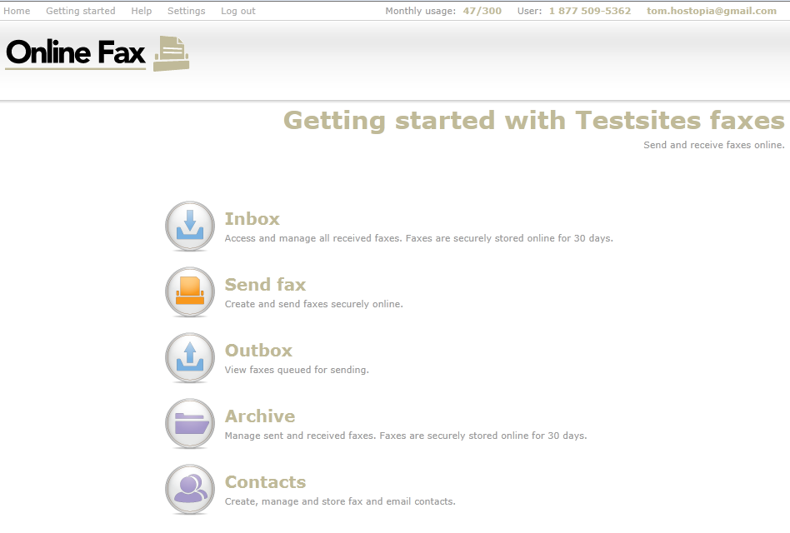
Online Fax
Notes:
After logging in, users can access their inbox, send a fax, access their outbox and archive, or manage their contacts.

Slide 9
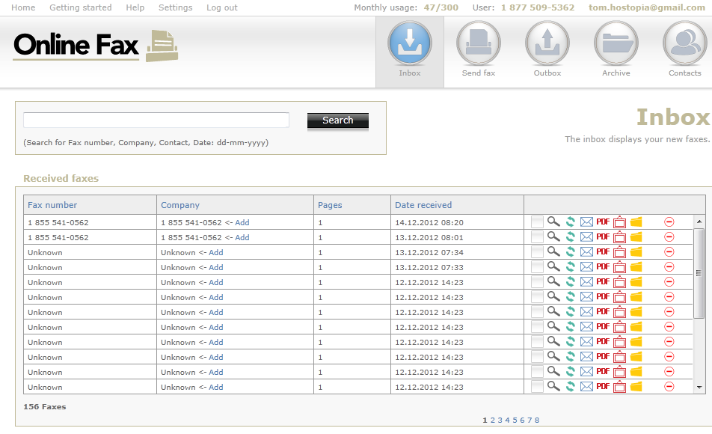
Online Fax
Notes:
From the inbox the user can view fax, rotate fax, email fax, download PDF, download TIFF, move to archive.
Includes a monthly meter usage at the top left so you always know how many pages you sent.

Slide 10
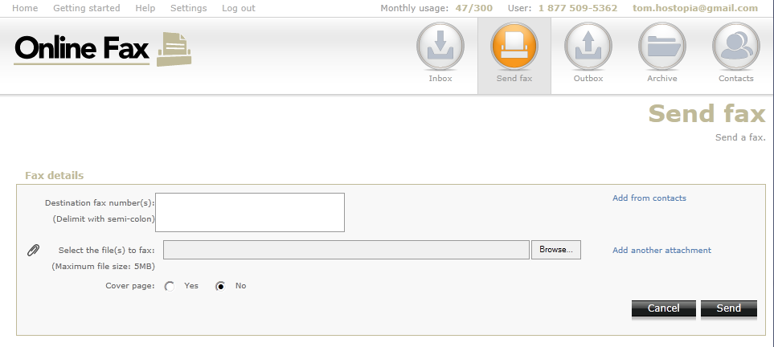
Online Fax
Notes:
To send a fax, simply type in the destination fax number (or choose from the list of contacts), upload the document and click “send”. You have the choice to add a cover page if you’d like.

Slide 11
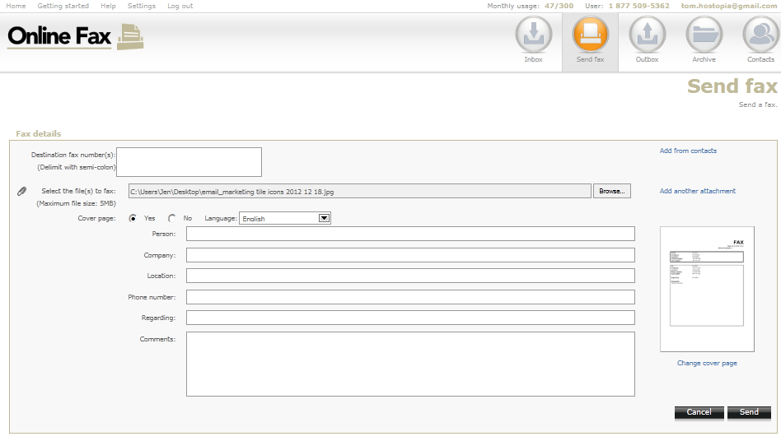
Online Fax
Notes:
To add a cover page, click on YES and more options will appear. Simply complete the fields (person, company, location) and then click on send.

Slide 12
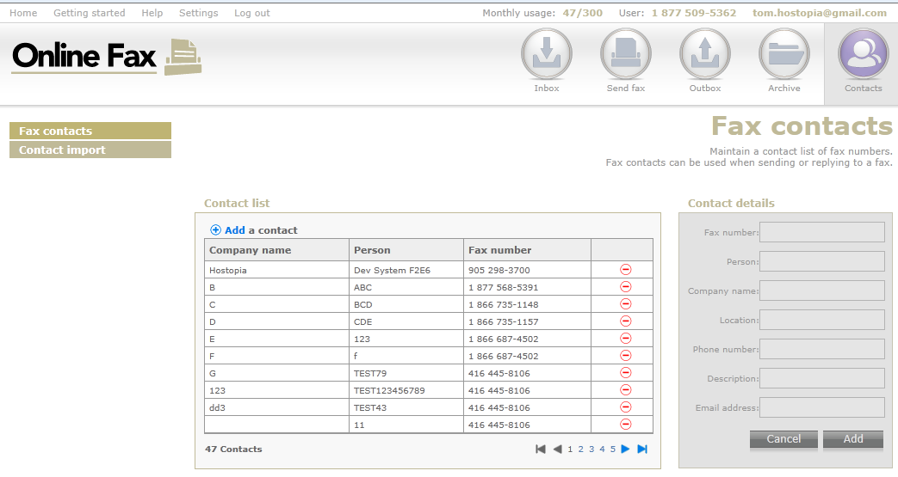
Online Fax
Notes:
For contact management, you can add contact individually (see area in grey) and click “add” or click on the “contact import” to import many contacts at one time. Contacts can be imported using a CSV (excel) file.

Slide 13


Online Fax
Plans & Pricing
FAX XXX
Send/receive up to 300 pages
$XX/m
FAX XXX
Send/receive up to 600 pages
$XX/m
FAX XXXX
Send/receive up to 1000 pages
$XX/m
FAX XXXX
Send/receive up to 5000 pages
$XX/m
Customize this slide to your offerings.
Fax number included
Additional pages - $0.10 per page
Plans are based on monthly usage; unused pages within a month are not carried over to the following months
Stand alone product

Slide 14
Online Fax
What is included in All Plans:
One North American toll-free number includes Hawaii and Alaska
Send and receive faxes anywhere with Internet access
Up to 5 existing email addresses to receive faxes
Online interface to manage fax account
Receive confidential information securely
1 Year total archiving of received faxes
Notes:
Plans do not include the ability to create email addresses but the ability to setup 5 existing email addresses that can receive faxes online. Since there is only one fax number per account, if a user sets up all 5 email addresses, all 5 will receive faxes.
This service does not support international dialing.
**CUSTOMERS CAN ONLY SEND AND RECEIVE FROM NORTH AMERICAN-BASED FAX NUMBERS** North America includes
When we refer to send ‘anywhere’, this means you can be in Europe and still access your (online portal )to send and receive faxes to local North American numbers.
Marketing/Sales verbiage: Send and receive faxes anywhere in North America from anywhere in the world where you have Internet access.

Slide 15
Online Fax
Features & Benefits
Save on long distance
Easy to use, can be online quickly
No dedicated fax line required
Auto resend and delivery notifications
Call logs track all incoming and outgoing faxes and store digital images of files for later access.
No more busy signals
Go green! Environmentally friendly
Securely send & receive confidential faxes
Send & receive from anywhere

Slide 16
Online Fax
Objection Handlers
“I already have a fax machine.”
Did you know with Online Fax…..
You no longer need a fax machine or to maintain one
You no longer need to circle around the fax machine
You can check faxes on the road, in meetings or at home
“I have confidential faxes to send.”
Add more security to your fax communication.
Faxes delivered to intended recipient
Faxes sent through a secure platform
Fax are not left lying on a fax machine
Archive faxes securely for up to 1 year
Notes:
Archive faxes securely for up to 1 year. The one-year time frame begins the day the fax is received.

Slide 17
Online Fax
Objection Handlers
“I’m not sure if I can afford switching.”
Save time and money with Online Fax.
No need for a dedicated fax number
Reduce paper & toner usage
Check faxes on the go
No need to monitor the fax machine
“I use business email to send faxes.”
Did you know….
That there are several business that will only accept and send
documentation through faxing?
Government and Doctor offices to name a few
We recommend small businesses have a way to share documents
through an online fax solution in addition to their business email
option

Slide 18
Online Fax
FAQs
“Do I need to download software or install anything?”
There is no need for installation or software. Online Fax is entirely web-based and ready to go once you sign up.
“How can I access faxes on the go?”
Since Online Fax is accessible anywhere there is internet connection, you can monitor your faxes on your mobile device, laptop, tablet or desktop. Whether you are in your car, in a meeting or at home.

Slide 19
Online Fax
Ordering Process
<<insert the internal ordering process for Online Fax>>

Slide 20
Online Fax
Resources
<< list out available resources that your agents have. E.g., Sales coaches, intranet, handouts, FAQs…>>

Slide 21
Questions or comments?

